Slide 1

Department of Electronics & Communication
Engineering
Face Recognition Smart Door Lock System
Batch No: B08
Domain: Embedded and IOT
Guided By: Mr.A.Shafeek AP(SS)/ECE
Review : 01
Presented By,
1. S.Naveen (727622BEC110)
2. S.Pranesh (727622BEC018)
3. M.Adhil (727622BEC114)

Slide 2
Contents
Problem Statment
Objectives
Abstract
Introduction
Module Description
Requirements
Flowchart
Block diagram
Literature survey
WeeklyPlan
Result
References

Slide 3
Problem Statment
Traditional locks lack advanced security and real-time information about visitors. This project develops a smart door lock system using Raspberry Pi and face recognition. The system grants access only to authorized individuals and notifies the owner of unrecognized visitors using facial capture and comparison

Slide 4
Objectives
Develop a smart door lock system using Raspberry Pi and face recognition to enhance home security.
Implement automatic door unlocking for recognized individuals and email notifications for unknown visitors.
Integrate hardware components like LCD screen, buzzer, LED lights, and motion sensor for a user-friendly solution controlled by Python.
Notes:
e

Slide 5
Abstract
This project presents a smart door lock system using Raspberry Pi and face recognition. It enhances home security by allowing only recognized individuals to enter and notifying the owner of unknown visitors.
When someone rings the doorbell, their face is captured and compared against a database. If recognized, the door unlocks automatically; if not and no one is home, a live picture is emailed to the owner.

Slide 6
Introduction
Addressing Limited Security: A Smart Door Lock with Face Recognition
Traditional door locks offer limited security, leaving homes vulnerable. This project introduces a smart door lock system leveraging Raspberry Pi and face recognition technology.
This system grants access only to authorized individuals identified through facial recognition, enhancing both security and convenience.
For unrecognized visitors, it captures a live image and sends it to the homeowner's email, allowing for informed decision-making and potential remote action.

Slide 7
Module Description
Capture & Compare:
Camera captures visitor image, compared via facial recognition for access control.
2. Authorize or Notify:
Raspberry Pi grants access for recognized individuals, triggers notification for others.
3. Alert If Unoccupied:
Sends live image to homeowner's email if no one is home and a visitor is unrecognized.

Slide 8
Requirements
Hardware Requirements: 1. Raspberry Pi 2. Camera 3. LCD 4. Buzzer 5. LED 6. Sensor 7. Motor | Software Requirements: 1. Raspbian 2. Python 3. Face recognition

Slide 9
Tools to be used for implementing the project
Hardware:
Raspberry Pi: Central processing unit
Camera Module: Captures visitor images
PIR Sensor: Detects presence/absence
Door Sensor: Monitors door state
LCD Screen: Displays messages
Buzzer: Provides alerts
LED: Shows status

Slide 10
Tools to be used for implementing the project
Software:
Operating System: Runs on Raspberry Pi
Python Programming Language: Controls hardware and performs facial recognition
OpenCV Library: Processes camera images
Facial Recognition Library (Optional): Identifies faces

Slide 11
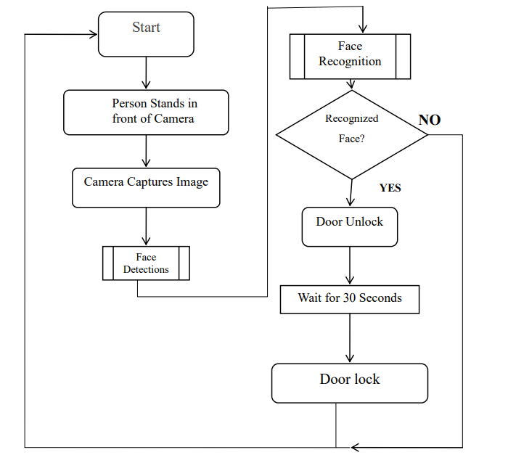
Flowchart

Slide 12
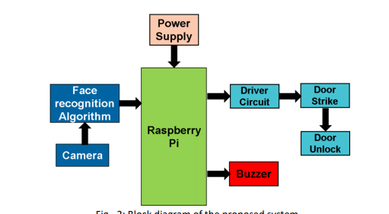
Block diagram

Slide 13
Literature survey
Sl. No | Authors | Title of the paper | Journal | Year
1 | Muhammad Waseem; Sundar Ali Khowaja | Face Recognition for Smart Door Lock System using Hierarchical Network | IEEE- 2020 International Conference on Computational Intelligence (ICCI) | 2020
2 | Tri-Nhut Do; Cong-Lap Le | IoT-Based Security With Facial Recognition Smart Lock System | IEEE-2021 15th International Conference on Advanced Computing and Applications (ACOMP) | 2021
3 | Muneera Begum H; Jayasri S | Face Recognition Door Lock System Using Raspberry Pi | IEEE-2020 International Conference on Computational Intelligence (ICCI) | 2020

Slide 14
Work plan
Week Tasks | Week1 (09.2.24 to 16.2.24) | Week2 (16.2.24 to 23.2.24) | Week3 (1.03.24 to till now) | Upcoming Weeks | Status
Title Selection |  |  |  |  | Completed
Objective |  |  |  |  | Completed
Component analysis |  |  |  |  | Completed
Design |  |  |  |  | Completed
Result |  |  |  |  | In progress
Project Completion |  |  |  |  | In progress

Slide 15
Work Completed for First review
Week Task | Week1 (06.2.2024 To 12.2.2024) | Week2 (16.2.2024 To 23.2.2024) | Week3 (27.02.2024 To Till now) | Status
Topic Analysis |  |  |  | Completed
We have learnt about the project |  |  |  | Completed
PPT preparation |  |  |  | Completed
Components purchasing work |  |  |  | In-progress

Slide 16
Results
Now we are purchasing the required components for the project .After purchasing the components we will start doing our hardware project

Slide 17
References
1. “Muhammad Waseem; Sundar Ali Khowaja”,Face Recognition for Smart Door Lock System using Hierarchical Network “IEEE- 2020 International Conference on Computational Intelligence (ICCI)”
2.”Tri-Nhut Do; Cong-Lap Le”,IoT-Based Security With Facial Recognition Smart Lock System, “IEEE-2021 15th International Conference on Advanced Computing and Applications (ACOMP)”
3.”Muneera Begum H; Jayasri S”, Face Recognition Door Lock System Using Raspberry Pi,IEEE-2020 International Conference on Computational Intelligence (ICCI).

Slide 18
References
4.“Promise Elechi, Ela Okowa”, Facial Recognition Based Smart Door Lock System, FUPRE Journal of Scientific and Industrial Research Vol.6, (2), 2022.
5.”Y. Jeevan Nagendra Kumar, G. Shiva Kumar” ,Face Recognition and Raspberry Pi Powered Smart Door Unlocking System”E3S Web of Conferences 391, 01087 (2023).
6. “Harvani Yedulapuram” ,Automatic Door Lock System by Face Recognition”,OP Conference Series: Materials Science and Engineering”.

Slide 19


